Slide 1




SIMAD University
ONLINE SHOPPING MANAGEMENT SYSTEM
SIMAD UNIVERSITY - Faculty of Computing Course: Oracle . SYSTEM Name: CARFOON Online-shopping.

Slide 2
Introduction
Online shopping has transformed modern commerce.
Efficient database management is essential for handling products, customers, orders, and payments.
This project develops an Online Shopping Management System using Oracle SQL.
The application is built with Python Tkinter connected to an Oracle Database.
2

Slide 3
Problem Statement & Objectives
Problem Statement
* Data redundancy
* Slow database performance
* Inconsistent records
* Poor scalability*
Difficult transaction management
Objectives
Design a normalized Oracle database.
* Improve data integrity.
* Support efficient order processing.
* Build a secure and scalable shopping system.
3

Slide 4
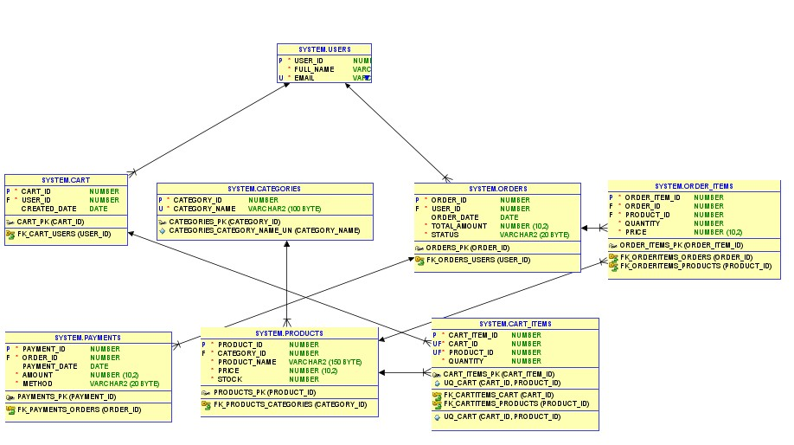
Database Design (ERD & Main Tables)
ER Diagram
Main Database Tables
Users
Categories
Products
Cart
Cart Items
Orders
Order Items
Payments
4

Slide 5
Methodology
Development Process
1. Requirement Analysis
2. Database Design
3. Table Creation
4. Relationship Implementation
5. Normalization (3NF)
6. Apply Constraints
7. Testing and Validation
Constraints Used
PRIMARY KEY
FOREIGN KEY
UNIQUE
CHECK
5

Slide 6
PL/SQL Package & Database Triggers
PL/SQL Package
PKG_ORDER_MANAGEMENT
Purpose:
Centralizes business logic
Improves maintainability
Supports reusable procedures
Database Triggers
Update product stock automatically
Generate product IDs
Audit inventory changes
Track order status updates
6

Slide 7
System Features
Customer Features
Shop catalog.
My Shopping Cart
My Orders & Payments Cart .
Administrator Features
Admin Dashboard
Products
Categories
Orders
Payments
Users List
7

Slide 8
Testing & Results
Sample Records
Table Name | Row Count | Purpose
CATEGORIES | 16 | Stores product category labels
PRODUCTS | 69 | Stores product information and inventory items
USERS | 3 | Manages user accounts, credentials, and permissions
ORDERS | 10 | Stores customer order records
PAYMENTS | 10 | Maintains payment transaction records
ORDER_ITEMS | 13 | Contains details of purchased items within each order
ORDER_AUDIT_LOGS | 115 | Records security and audit log activities
CART | 2 | Stores shopping cart session information
Database Status
Oracle Database running successfully
All tables created
PL/SQL package compiled successfully
All triggers enabled
7

Slide 9
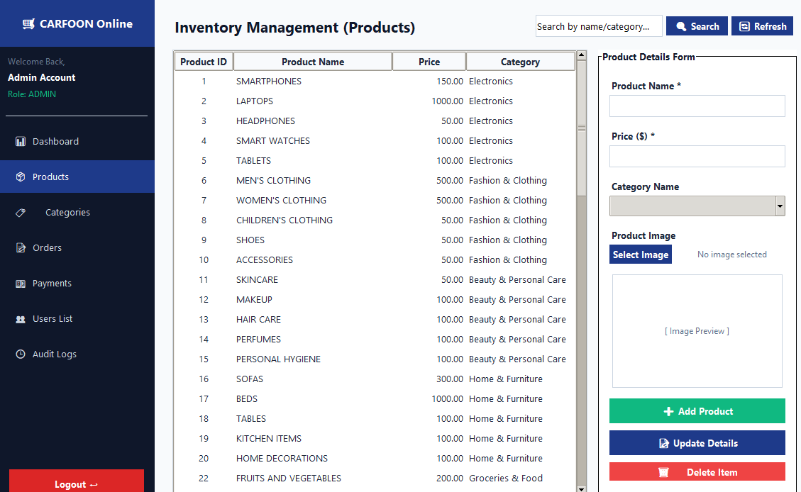
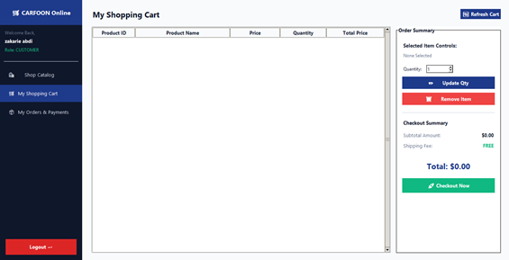
Testing Screens
Admin front-end page.
Customer front-end page.
7

Slide 10
Future Improvements
Online payment gateway integration
Mobile application
Cloud database deployment
Email notifications
Advanced analytics
7

Slide 11
Conclusion
Successfully developed an Online Shopping Management System.
Oracle SQL provides reliable and efficient data management.
PL/SQL packages and triggers automate database operations.
Python Tkinter offers an interactive desktop interface.
The system is scalable, secure, and suitable for real-world e-commerce applications.
7

